Slide 1
UCCX: How to Record Prompts
Your Host: Marty Griffin Contact Center Technical Instructor Sunset Learning Institute

Slide 2
Session Goals and Objectives
“To introduce a simple, easy- to-use recording tool for Cisco Unified Contact Center Express Applications. The recording tool is now available for download from the Sunset Learning Web site.”

Slide 3
UCCX Prompt Recording Overview
Traditional Recording Methods
Record prompts in Unity or Unity Connection, copy file to UCCX
Send text to a professional recording studio
Use Text-to-speech
The Issues
Script developers need to record “scratch” prompts for testing
Customers wish to change or create promotional prompts on the fly
Customers want an application for professional voices to call and record
Our Solution
Create an application and script for recording prompts
Application can review existing prompts, record new prompts and upload the prompts to the script repository for immediate use
Application available for use by customer’s developers and for simple prompt administration by authenticated sales, marketing people

Slide 4
Prompt Specifics
Prompts must be either recorded or converted to G.711 format
Audio sample size: 8-bit words
8,000 samples per second
Audio Format: CCITT u-law
Channels: 1 (Mono, not stereo)
Bit Rate: 8-bits X 8,000 = 64Kbit Audio

Slide 5
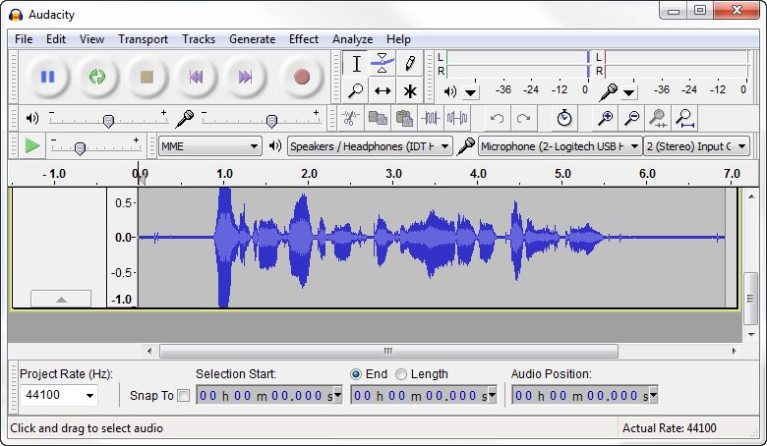
Some Free Commercial Recording Tools
Audacity: For recording the prompts (free)

Slide 6
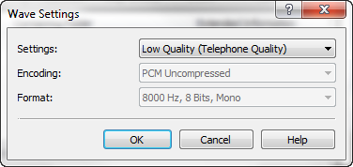
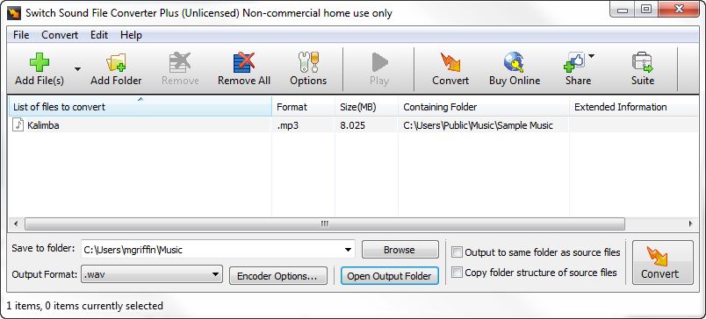
Some Free Commercial Recording Tools
Switch Audio File Converter: For converting .wav files to the G.711 .wav format, (free)

Slide 7
About the RecordPrompts.aef Script
The recording script is derived from an old script version
Modified for newer versions, capabilities of CCX
Addresses authentication requirements for newer CCX versions
Upload credentials are CUCM User Name and Password, configured as variable parameters on the CCX Application Page
Sunset Learning download includes script and supporting prompts

Slide 8
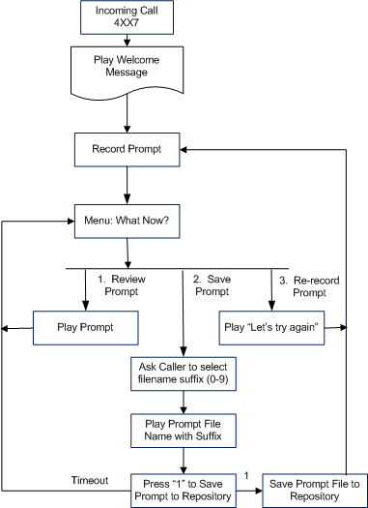
Script: RecordPrompts.aef
The flow for this script is:
Answer the call with a welcome message
Ask the caller to record a prompt, when finished, press “#”
Ask if the caller would like to:
Review the recorded prompt
Play the prompt, return to menu
Save the prompt
Ask for file name suffix
Play file name with suffix
Confirm save
Write to prompt repository
Re-record the prompt
Return to Record Prompt

Slide 9
Prepare the Script and Prompts
Download and the Script and Prompts
The RecordPrompts.zip file contains the script and supporting prompts
Download the RecordPrompts.zip file from:
http://www.sunsetlearning.com/Contact-Center-Express–A-Prompt-Recording-Script-and-Tutorial
Unzip the files to your PC
Upload the Script and Prompts to CCX
Using CCX Administration > Script Management, upload the RecordPrompts.aef script
Using CCX Administration > Prompt Management, upload the Prompts.zip file and it will expand and unzip
Now let’s build an application for this fun

Slide 10
Video 1
Call the Test_RP script X5001
Unzip the RecordPrompts.zip file
Upload the two scripts
Upload the zip files
Prepare an application “Record Prompts”
Prepare a Trigger X5000
Adjust the Parameters on the Application
Call the record application X5000 and record a new welcome announcement

Slide 11
Debug: RecordPrompts.aef

Slide 12
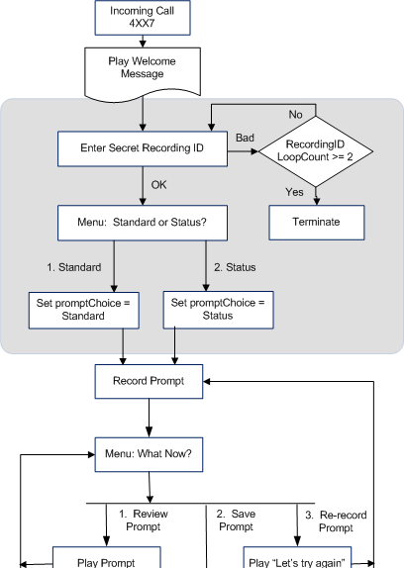
Script: RecordAll.aef
The modification for this script is:
Ask caller for secret ID based on UCM user PIN
Ask for Standard or Secret recording, set variable
Continue with Recording Prompt
Student<XX>.aef script to be modified to play status prompt uploaded by RecordAll.aef script

Slide 13
Join Us In Class!
Plan and Schedule one or more of our Cisco Unified Contact Center courses:
Unified Contact Center Express, v5.0 (UCCX50) for those learning deployment and administration techniques for the great product
Advanced Contact Center Express Scripting Lab (ACCXSL) for those who wish to apply advanced scripting techniques and take advantage of all UCCX capabilities

Slide 14
Thank you for Watching!
Be sure to visit our Web site and download these useful Contact Center Express recording tools:
http://www.sunsetlearning.com/Contact-Center-Express–A-Prompt-Recording-Script-and-Tutorial
Happy Recording! See you in class!
Marty Griffin Contact Center Technical Instructor Sunset Learning Institute mgriffin@sunsetlearning.com

